Slide 1

Bayley’s Favourite Baking Recipes
Name: Bayley Kryzanowski
Matriculation Number: 9218772
Course: Project: Java and Web Development
Course Number: DLBCSPJWD01
Phase 3: Finalization Phase
Tutor: Christian Remfert
Date: December 23, 2025
GitHub link: bayleykryzanowski/Baking_Recipes_App

Slide 2

Application Purpose and Concept
Name for Application: Bayley’s Favourite Baking Recipes
Purpose: Organize and store a personal, reliable, digital database for some of the best baking ideas at home. Be able to store, organize and easily retrieve favourite recipes. Can be edited for personal cooking notes and family recipes.

Slide 3
User Group and Benefits
User group: People who are interested in baking and have a need to keep their recipes stored safely in an online space with an organized, accessible system.
User Benefits:
Organization: Search and filter recipes by preparation time, ingredient or title.
Accessibility: Responsive web design will ensure recipes are readable and useable on all devices.
Security: Secure storage on the local back-end ensures data longevity and eliminates the risk of losing handwritten recipes.
Efficiency: Quickly look up instructions without having to sift through old papers or web-pages. Share, edit and delete recipes quickly.

Slide 4
Functional Requirements
Must be able to input a recipe and have it saved in the browser.
Must be able to view a list of all saved recipes and see essentials on summary cards.
Must be able to filter the displayed recipes by category and search by title or ingredient.
All submitted recipes must be saved to a local database on the back-end and be retrievable.
The layout must be responsive and adapt to different viewport size changed, maintaining usability on mobile devices.

Slide 5

Technical Components and Decisions
Architecture and Data Flow:
Front-end (Client): Handles the UI and collecting user input.
HTML, CSS, JavaScript for quick and effective responsive design that utilizes core web technologies.
API Request: Use JSON data to store back-end API.
Standardized and efficient communication protocol using a base URL.
Back-end(Server): Receives the HTTP request, processes the data and interacts with the storage layer.
Node.js with the express.js framework to provide a lightweight, fast and scalable runtime environment. Allows for use of plain JS across the entire stack.
Data Storage: The data is saved regularly.
Node.js & Express: Used to build a RESTful API and serve static frontend files.
FileSystem (fs): Used to persist recipe data in a local `recipes.json` file.
API Response: The server send a response back to the client.
Client Update: JS uses the received data to dynamically update the we application.

Slide 6
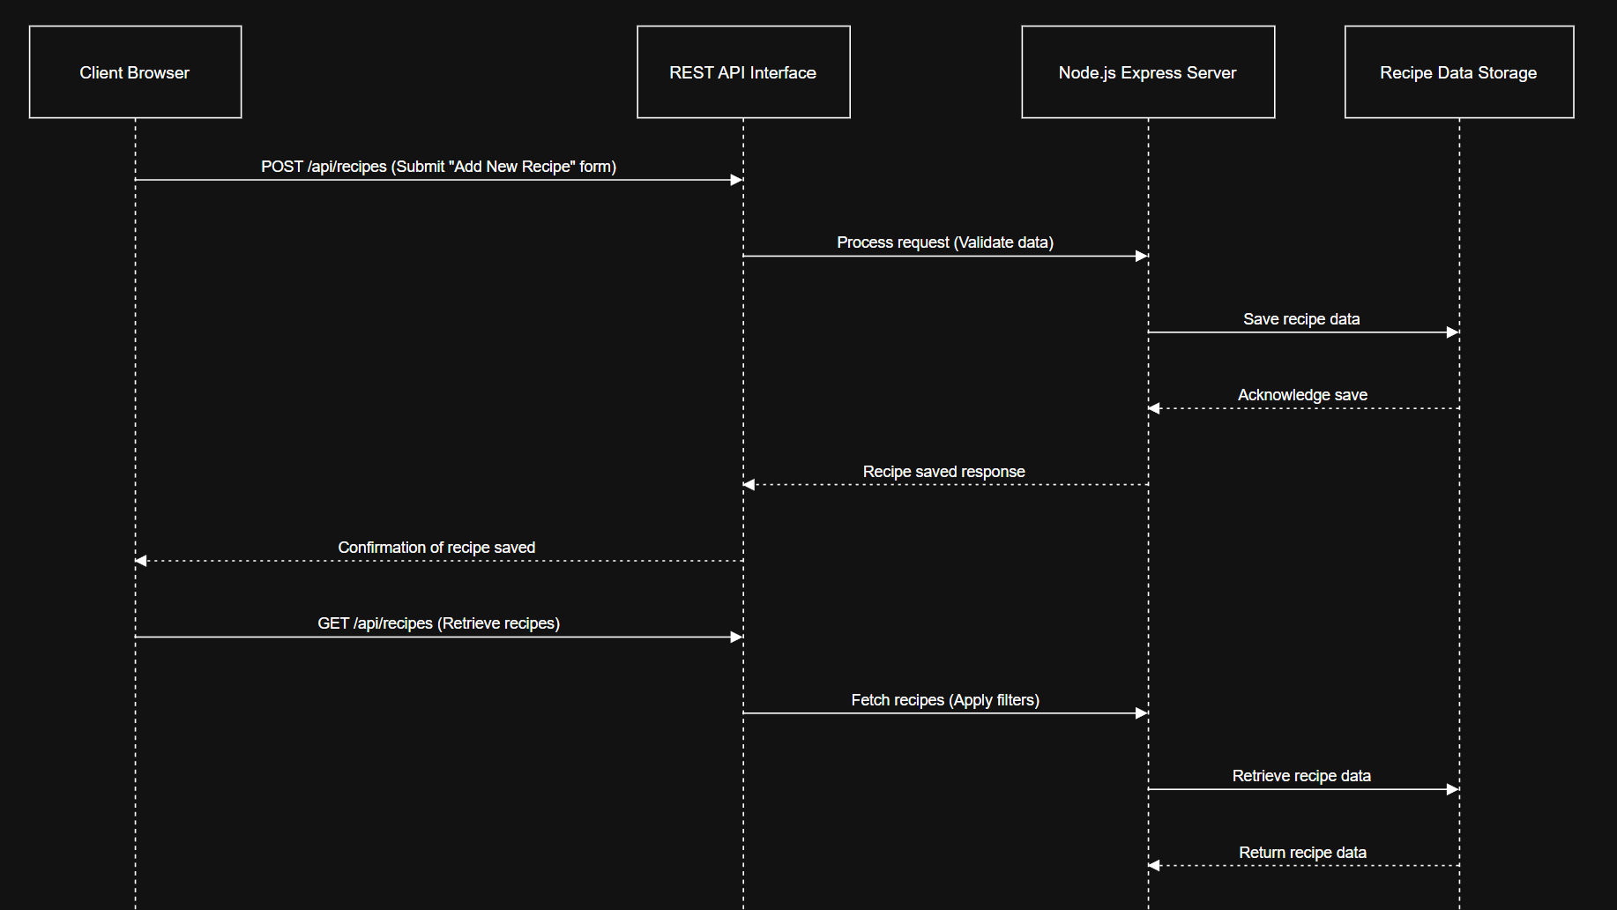

Slide 7

Phase 2

Slide 8

Title/Search Bar
Allows users to filter through recipes saved to the browser. The + Add New Button allows for auto-scroll to the form where the user can fill in their own new recipes.

Slide 9
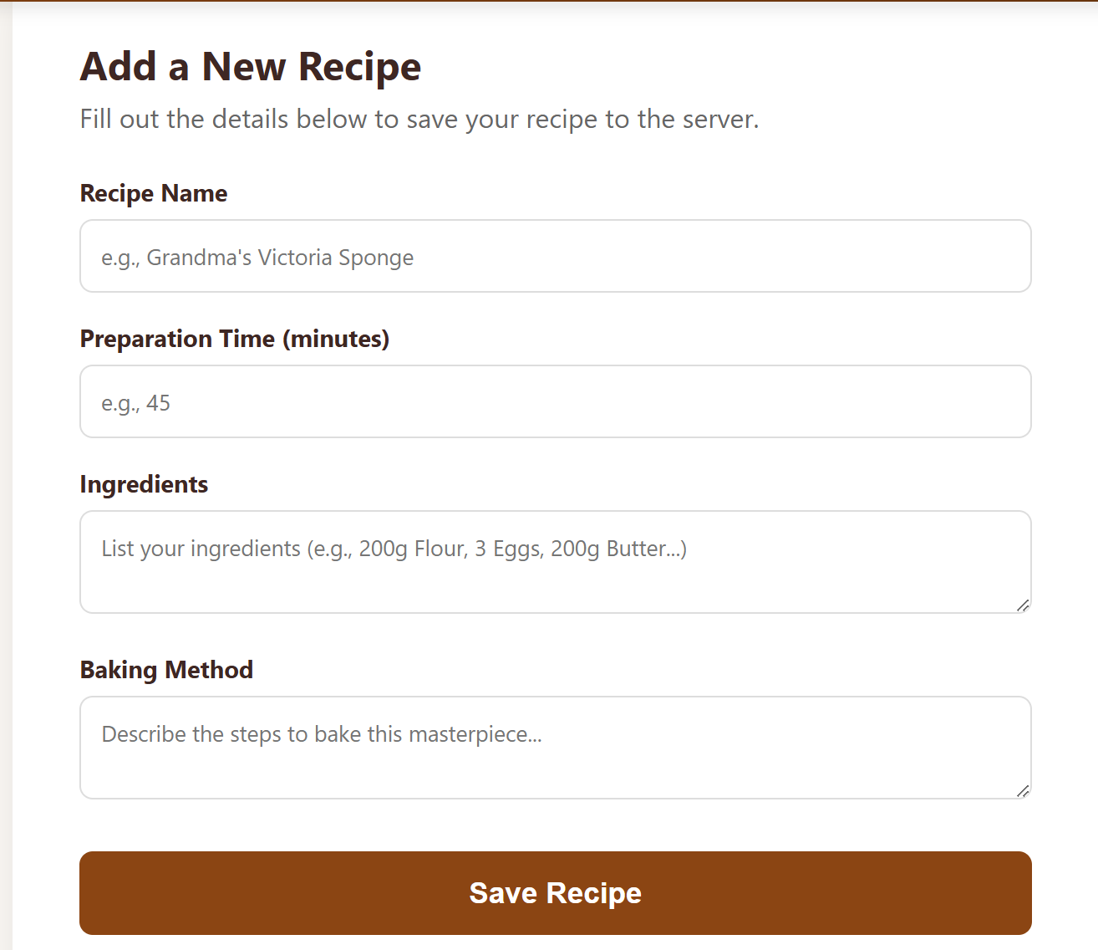
New Recipe
Users can add their own information here to create new recipes to be added to the collection!

Slide 10
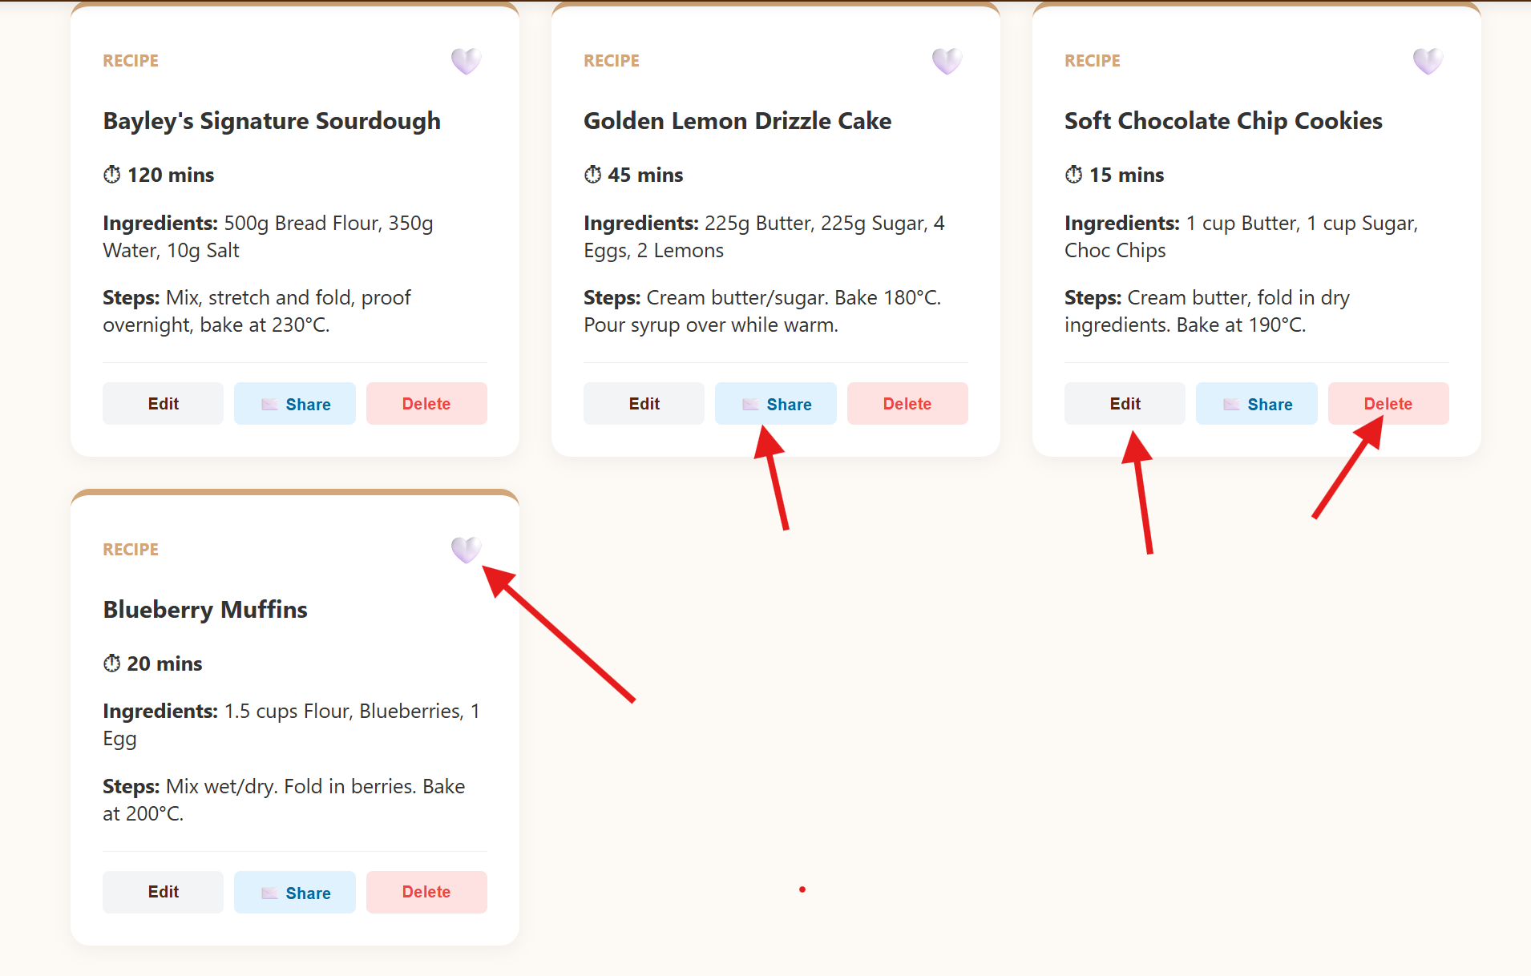
Edit/Delete/Share/Heart
Coded buttons to help improve the user experience!
Share the recipe over email!
Delete recipe button
Change needed?Edit the recipe card!
Heart! For saving as a favourite and moving to top of list

Slide 11
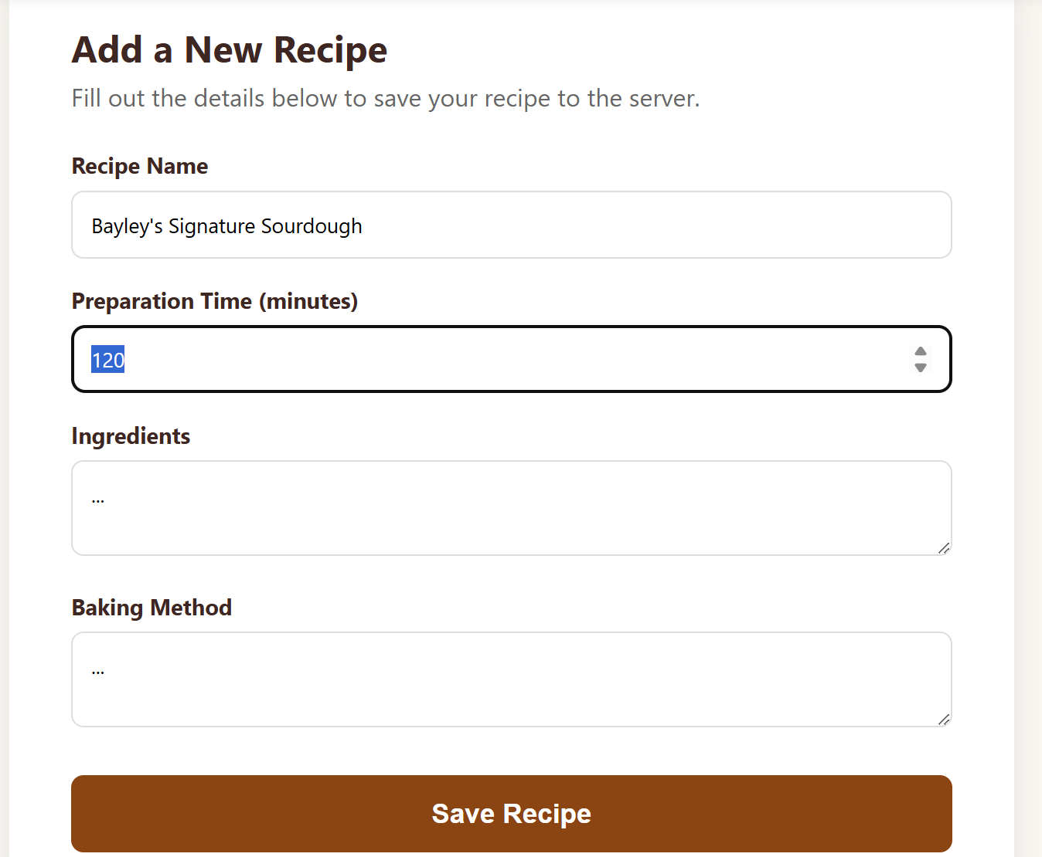

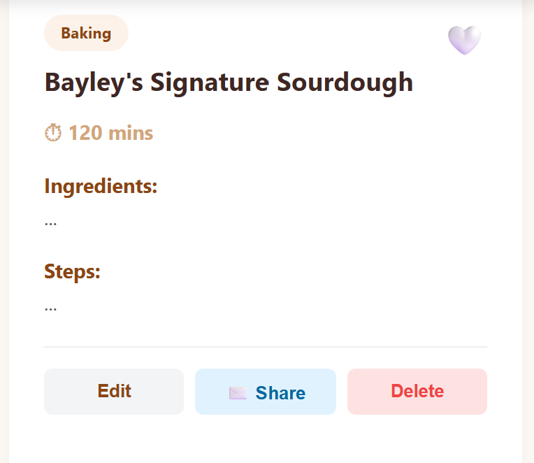
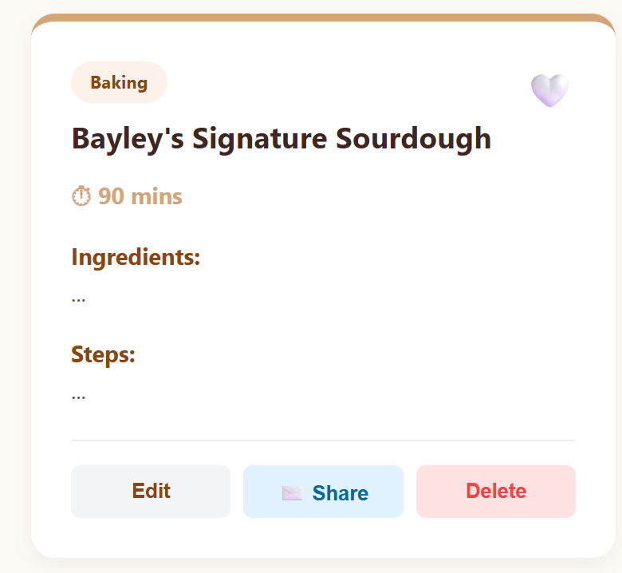
Test Case: Edit Button
When a user clicks “edit” the form should be auto-filled with the information saved on the server and be changeable for the user.
When they click “save recipe” the updated information will appear on the new recipe card.

Slide 12
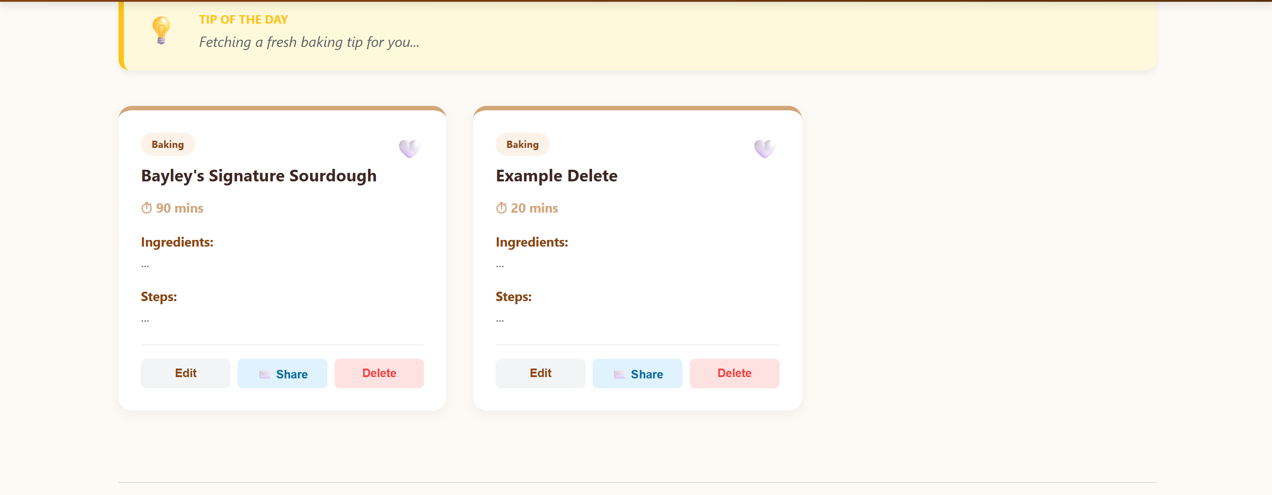
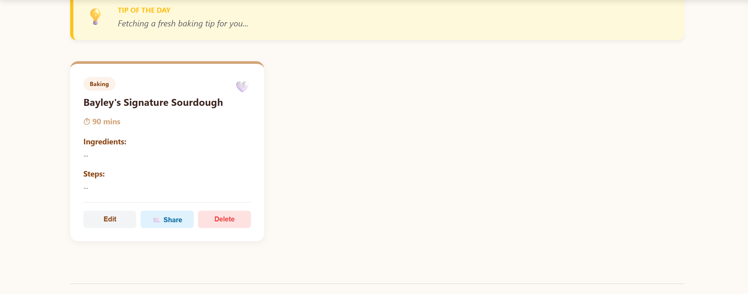

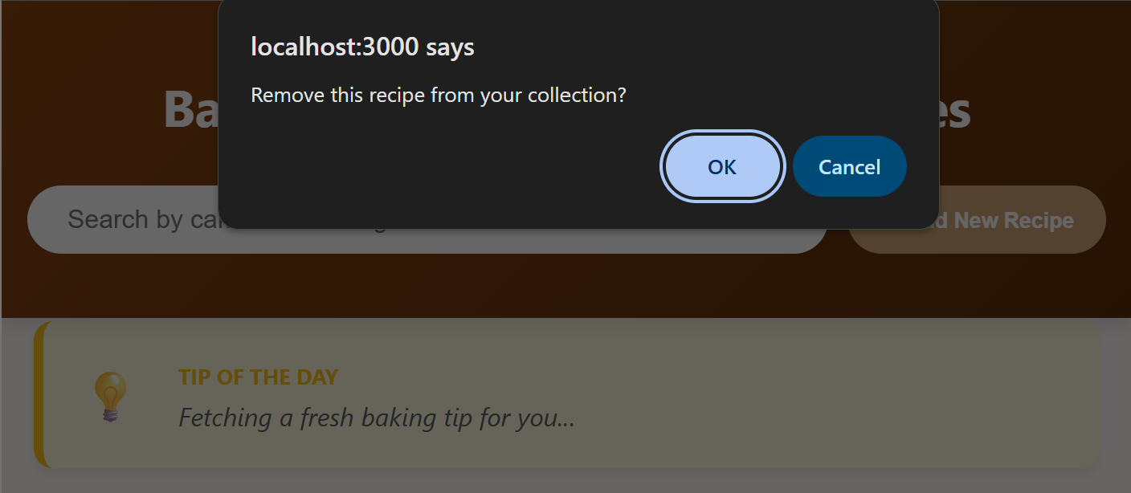
Test Case: Delete Recipe
Before:
After:

Slide 13
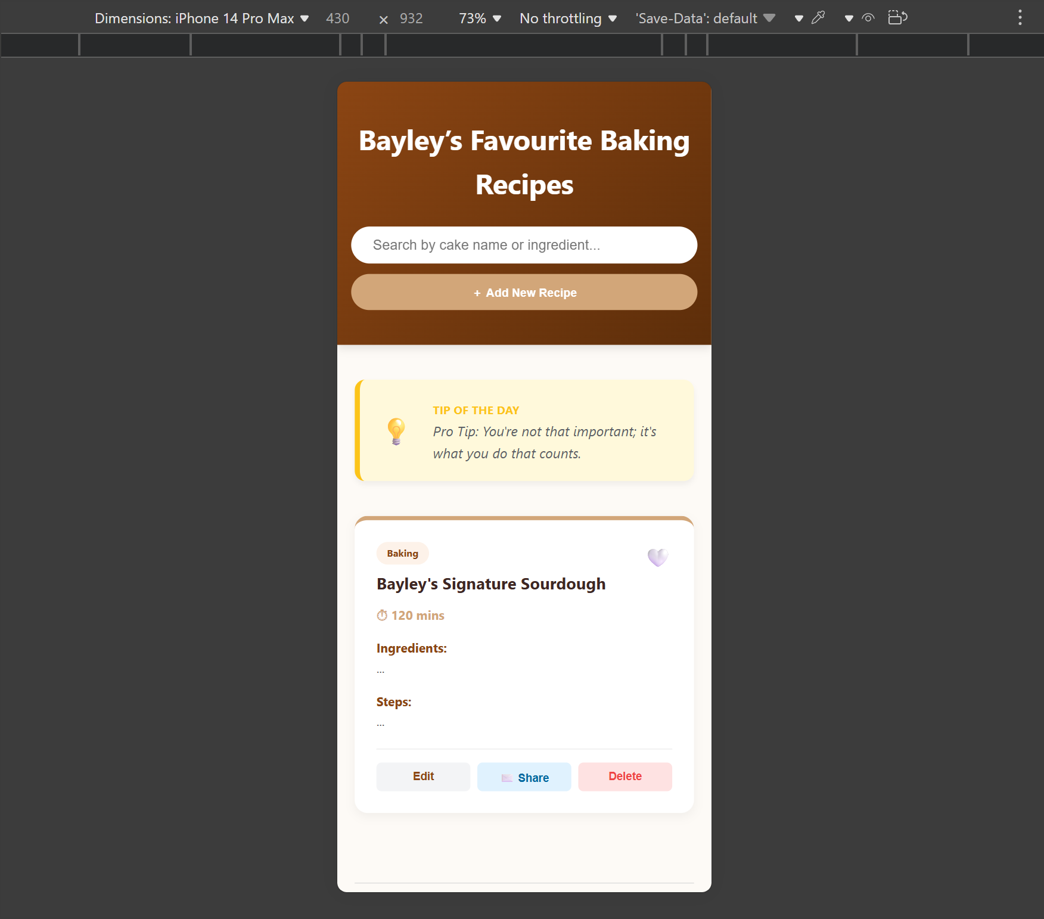
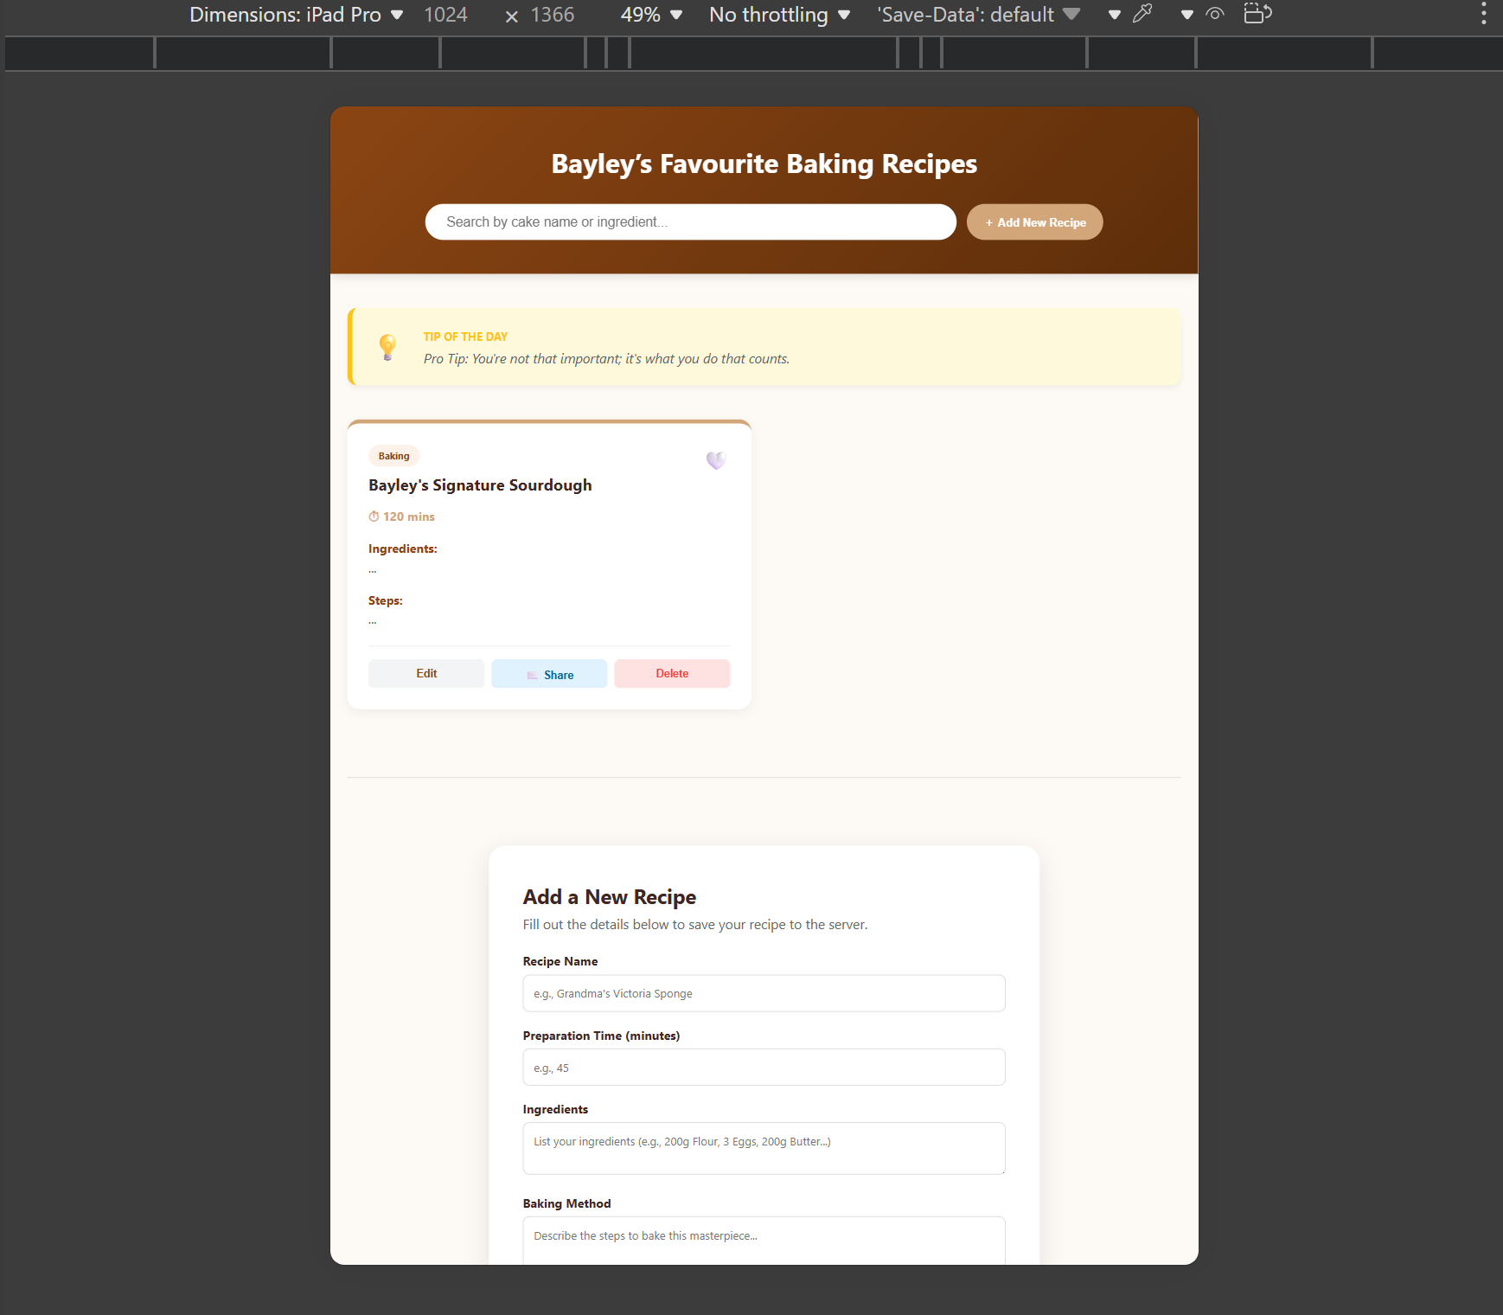
Responsiveness iPhone 14 Pro vs iPad Pro

Slide 14

Changes from Phase 1

Slide 15
Addition of Buttons
When I created the base html and started to change the style of the web application, it seemed to be missing something. I added the buttons(edit/delete/share/favourite) on the recipe cards to help with user interface and organization!

Slide 16
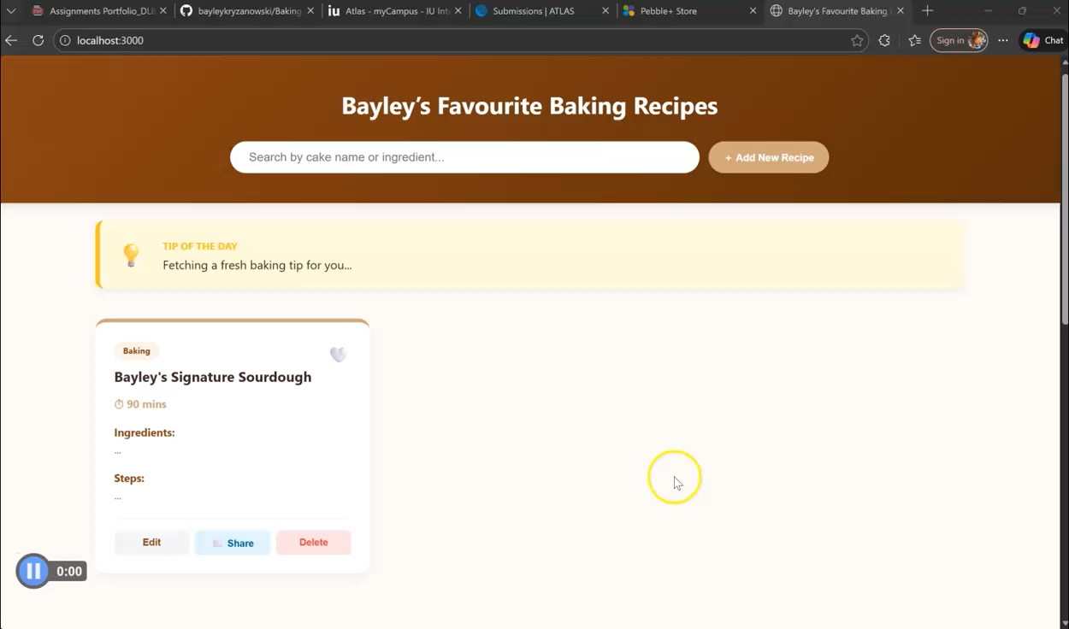
Screen Cast P2 (Updated)

Slide 17
Phase 3: Finalization

Slide 18

Backend Addition
Phase 2 feedback was that I was not fulfilling the requirements for the back-end so I had to make a lot of changes in order to make sure this application was meeting more than just the design goals. This included the use of Node.js and implementing more communication between the code itself to be able to save and store recipes in a local server.

Slide 19

Tip of the Day
Fun little addition for the requirement of outside API generation on the web app using a free source to not require any sign up for third party sources.

Slide 20
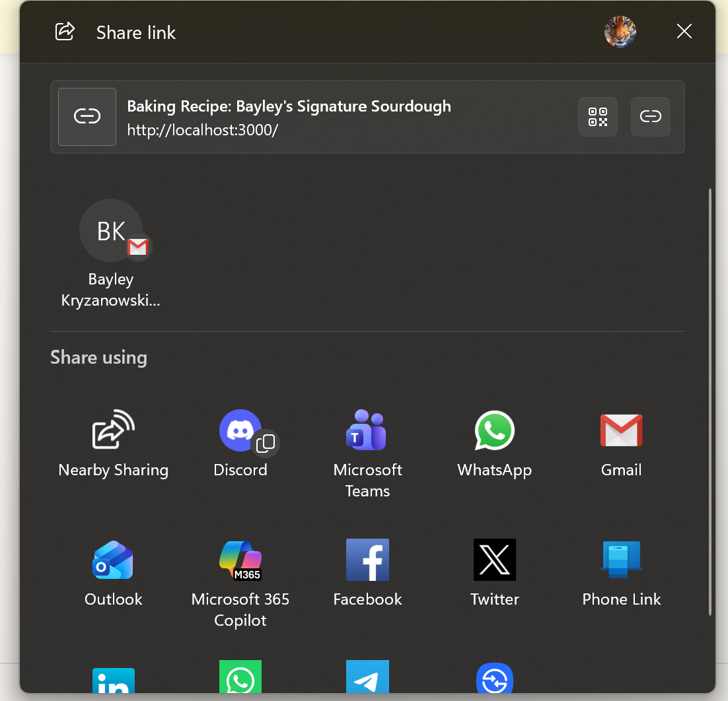
Updating Share Button Test Case:
I did not like how it automatically tried to use the computer’s default email browser, as I myself do not use it so I changed the functionality of the share button to include other options. When the user clicks “share” they now get this window.

Slide 21
Finalized User Features for Project:
Recipe Management: Create, view, edit, and delete baking recipes.
Favorites System: Pin your most-loved recipes to the top of the grid.
Tip of the Day: Real-time tips fetched from an external API, processed and transformed by the backend.
Email Sharing: Automatically format recipes into an email to share with others.
Responsive Design: Optimized for both desktop and mobile viewing.

Slide 22

Technical Details
Backend Technology
Node.js & Express: Used to build a RESTful API and serve static frontend files.
FileSystem (fs): Used to persist recipe data in a local `recipes.json` file.
External API Integration
API Used: [Advice Slip API](https://api.adviceslip.com/)
Transformation: The backend consumes the raw "advice" data, filters it, and transforms the object structure into a custom `dailyTip` format before sending it to the frontend. This ensures the frontend never communicates directly with third-party services.
Frontend Technology
JavaScript. Handles DOM manipulation, asynchronous fetch requests, and local filtering.
CSS3: Custom styles using CSS variables for a consistent "Bakery" theme
Submission Credentials
External API: Publicly available (No API Key required).
Database: Local JSON storage (Reset by clearing `recipes.json` to `[]`).

Slide 23
Lessons Learned
How to create and incorporate buttons in a web page design
Make a web application responsive to work on multiple devices
Attach a back-end to a web application for storage purposes that can be edited
Use style.css to manage how the web page design looks
Using GitHub to share code
Use an API to add to the web application

Slide 24
Future Additions
Add accounts where users could access it from anywhere
01
Have access to user interactions where they can see each others recipe lists
02
Be able to add video instructions or pictures of their results
03

